Slide 1
FPGA SIMULATION & AVENCEMENT
HIGH SPEED DATA LOGGER

Slide 2
SOMMAIRE
RESUME DU TB
ETATS ACTUEL DU TRAVAIL ET ETAPES EFFECTUEES
PLANIFICATIONS FUTURS

Slide 3
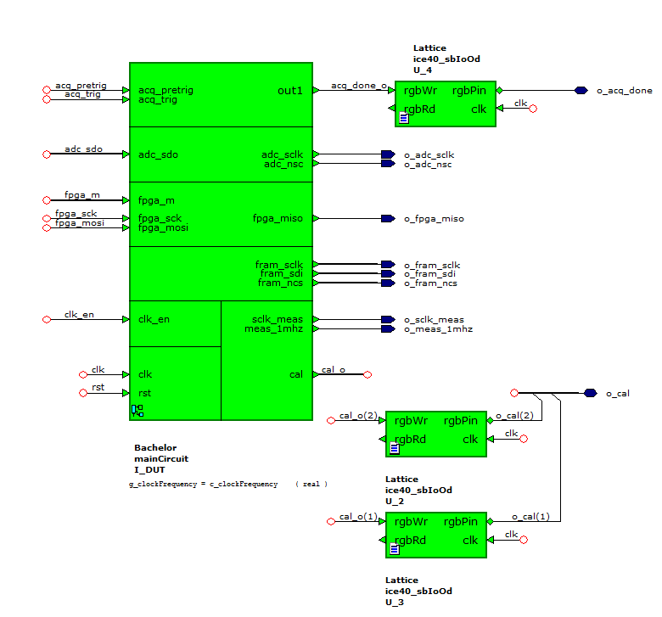
SIMULATION FPGA – SHEMAS BLOCKS
BLOCK PRINCIPALE

Slide 4
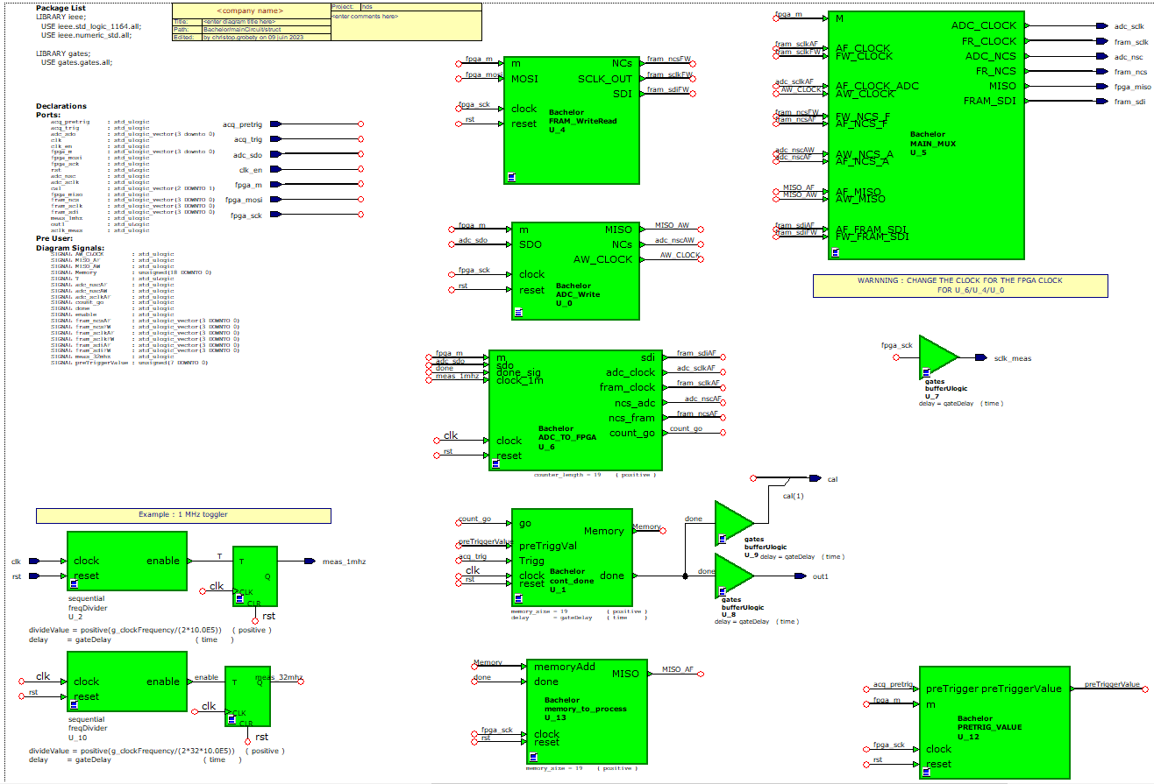
SIMULATION FPGA – SHEMAS BLOCKS
BLOCKS INTERNES

Slide 5
SIMULATION FPGA – M SELECTOR
SELECTOR STM32 -> FPGA
M | FUNCTION | CLK | TAILLE
OOO1 | WRITE ADC | STM32 | 16
OO1O | READ ADC | STM32 | 16
OO11 | NCS ADC ON | STM32 | 1
O1OO | READ FRAM A | STM32 | 32
O1O1 | READ FRAM B | STM32 | 32
O11O | READ FRAM C | STM32 | 32
O111 | READ FRAM D | STM32 | 32
1OOO | WRITE ALL | STM32 | 32 + MEMORY
1O1O | ADC TO FRAM | FPGA | 32+ INF. + PRETRIG
111O | PRETRIG VALUE | STM32 | 8

Slide 6
SIMULATION FPGA – PRINCIPEAUX CAS
CAS 1) M = ‘0001’ // WRITE RAM
ADC_SCLK
FRAM
STM32_SCLK
ADC_SDOx
FRAM
STM32_MISO
ADC_NCS
FRAM
STM32_M
ADC_SDIx
STM32_MOSI

Slide 7
SIMULATION FPGA – PRINCIPEAUX CAS
CAS 2) M = ’01xx’ // READ FRAM
FRAM_SCLK
FRAM
STM32_SCLK
FRAM_SDIx
FRAM
STM32_MISO
FRAM_NCS
FRAM
STM32_M
FRAM_SDOx
STM32_MOSI

Slide 8
SIMULATION FPGA – PRINCIPEAUX CAS
CAS 3) M = ’1000’ // ALL FRAM WRITE
FRAM_SCLK
FRAM
STM32_SCLK
FRAM_SDI(ALL)
FRAM
STM32_MISO
FRAM_NCS
FRAM
STM32_M
FRAM_SDOx
NULL

Slide 9
SIMULATION FPGA – PRINCIPEAUX CAS
CAS 4) M = ’1010’ //ADC TO FRAM
FRAM/ADC_SCLK
FRAM
FRAM_SDI(ALL)
FRAM
ADC_SDO(ALL)
FRAM/ADC_NCS
FRAM
STM32_M

Slide 10
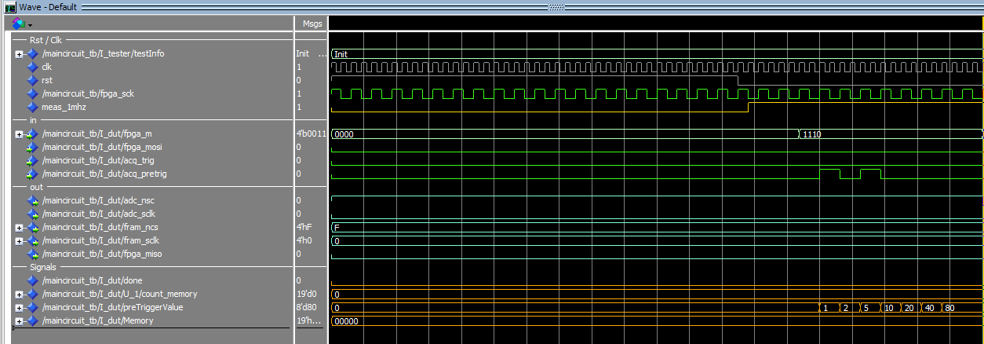
SIMULATION FPGA – PRETRIG VALUE
BASE 8

Slide 11
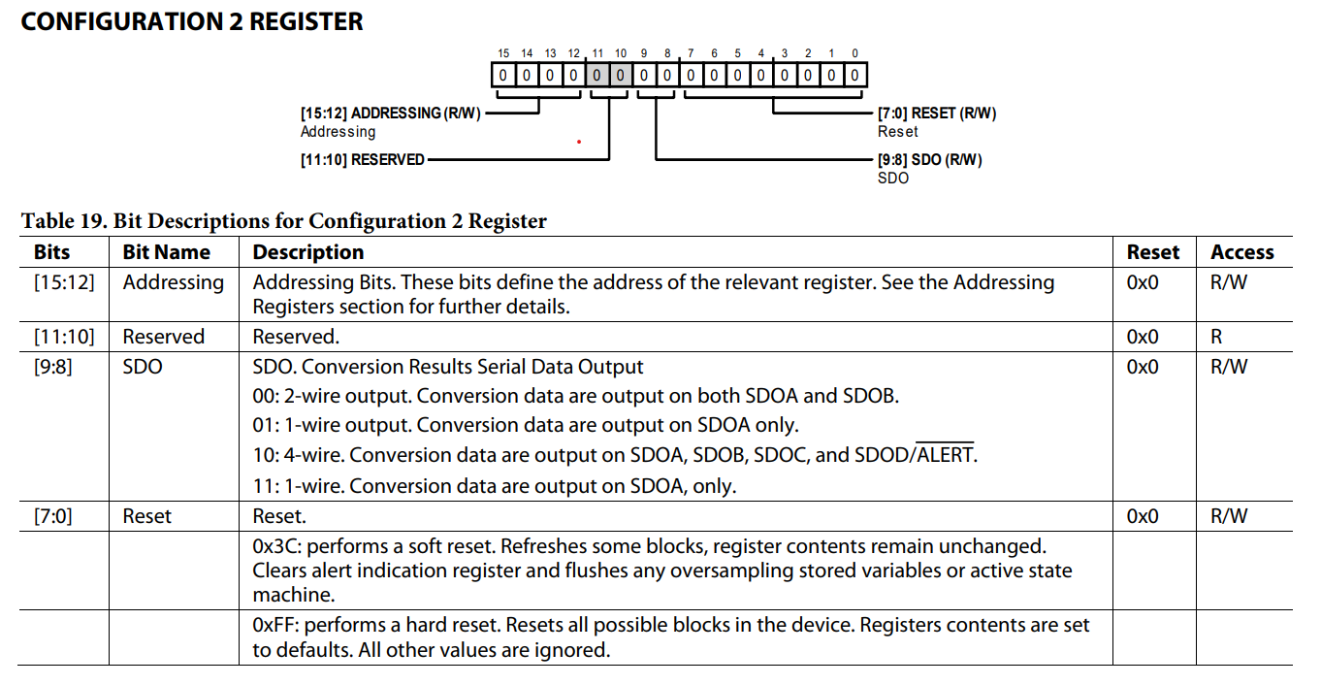
SIMULATION FPGA – ADC INIT
4-wire mode / REG 0X2
"1010’0010’1000’0000"

Slide 12
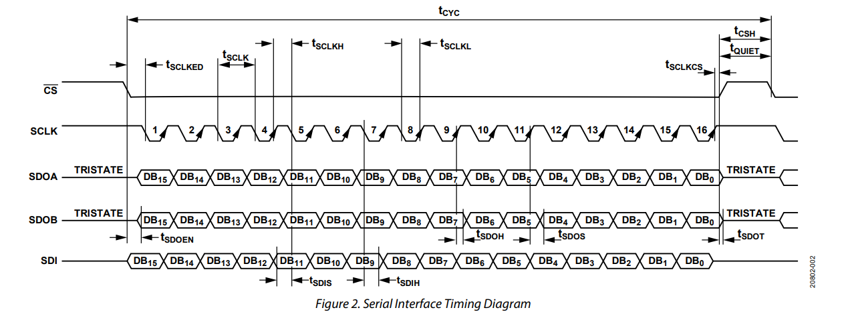
SIMULATION FPGA – ADC INIT
Tcyc = 250 ns // Tsclked = 5 ns min. // Tsclk = 12.5 ns min. // Tquiet = 20 ns min.
(sim) -> Tcyc = 1 us // Tsclked = 15 ns // Tsclk = 31.2 ns min. // Tquiet = 469.3 ns min.

Slide 13
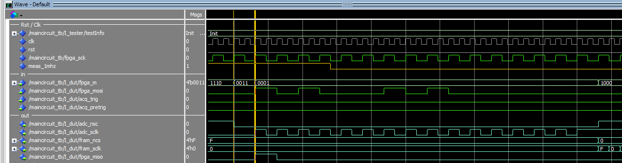
SIMULATION FPGA – ADC INIT
Géré par le STM32

Slide 14
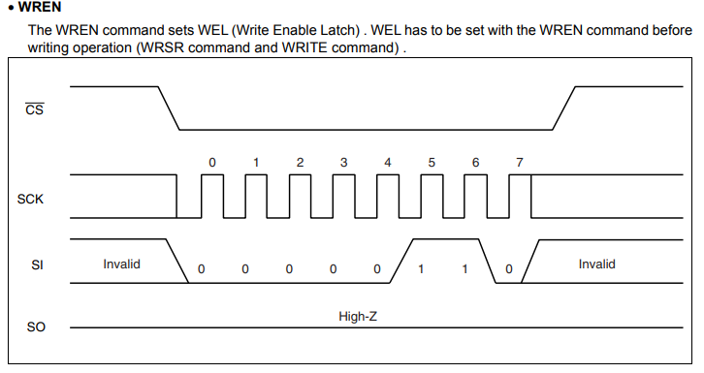
SIMULATION FPGA – FRAM INIT
PAS DE DECALAGE

Slide 15
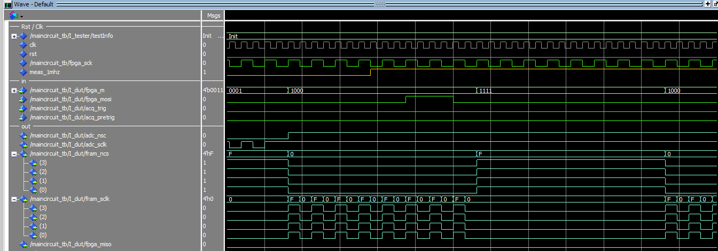
SIMULATION FPGA – FRAM INIT
GERER PAR LE STM32

Slide 16
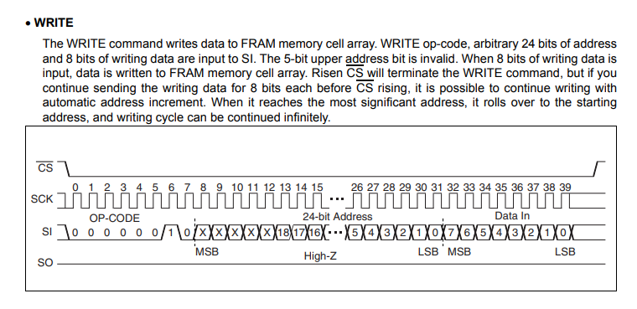
SIMULATION FPGA – FRAM WRITE
PAS DE DECALAGE

Slide 17
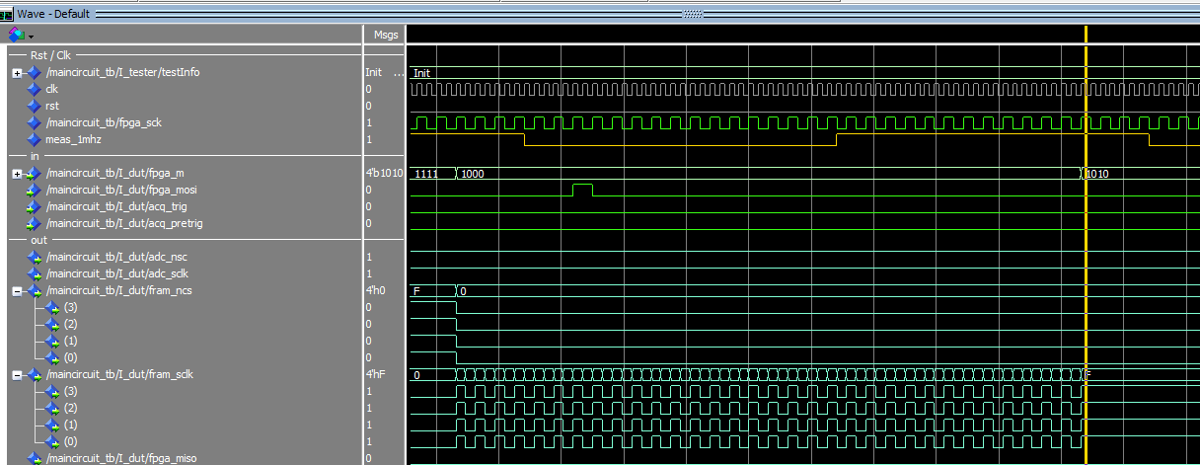
SIMULATION FPGA – FRAM WRITE
PAS DE DECALAGE

Slide 18
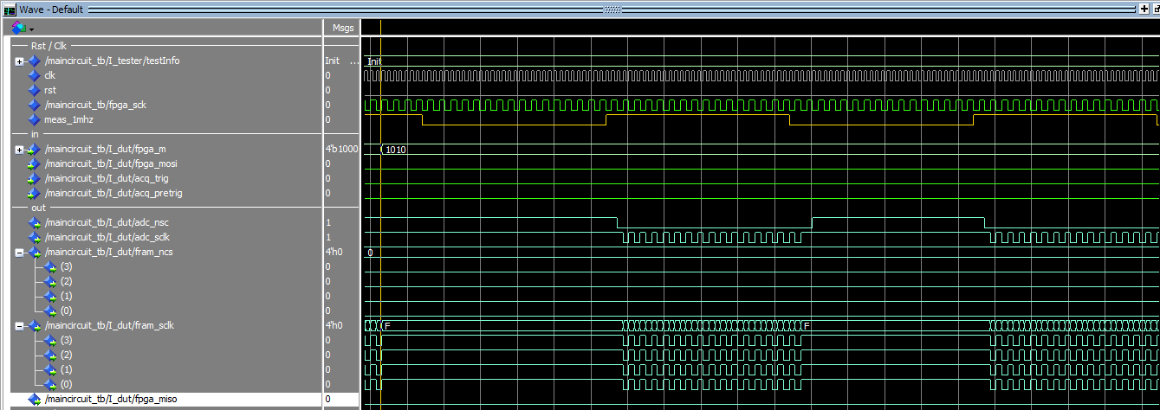
SIMULATION FPGA – FRAM WRITE
CHANGEMENT DE CLOCK

Slide 19

ACQ_CLK
$$1 μs$$
Derived from 64 MHz precision oscillator
ADC_nCS
16 rising edges
ACQ_SCLK
16 rising edges
ACQ_CLK
ACQ_SCLK
FRAM_0_SCLK
FRAM_1_SCLK
ADC_nSC
FRAM_2_SCLK
ADC_SCLK
FRAM_3_SCLK
ADC_SDO_0
FRAM_0_SDI
ADC_SDO_1
FRAM_1_ SDI
ADC_SDO_2
FRAM_2_ SDI
ADC_SDO_3
FRAM_3_ SDI

Slide 20
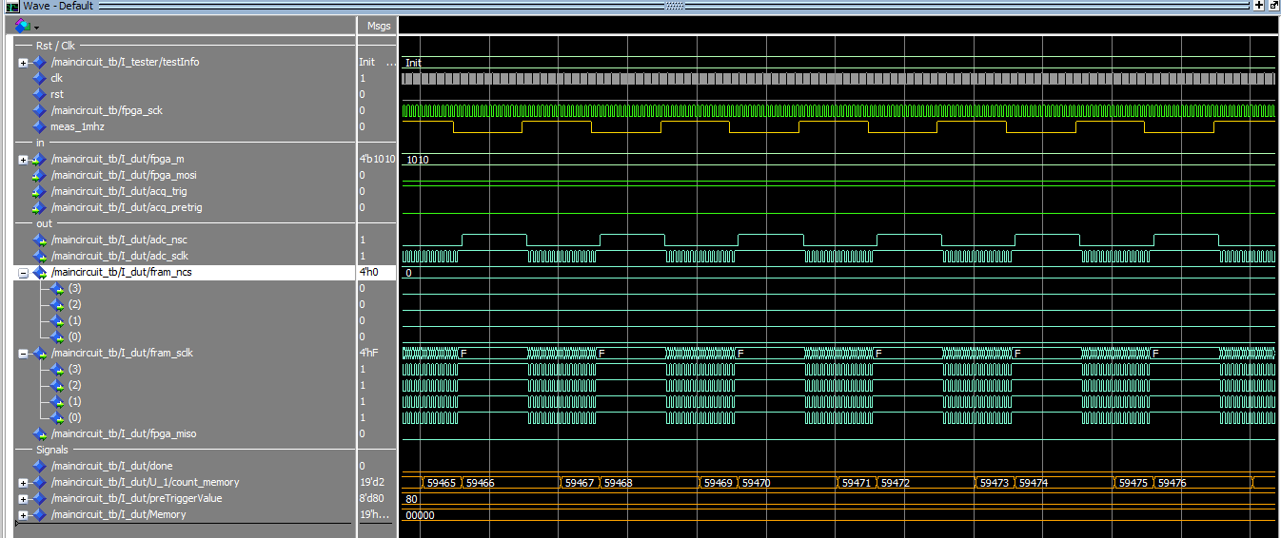
SIMULATION FPGA – FRAM WRITE
INCREMENTATION MEMORY

Slide 21
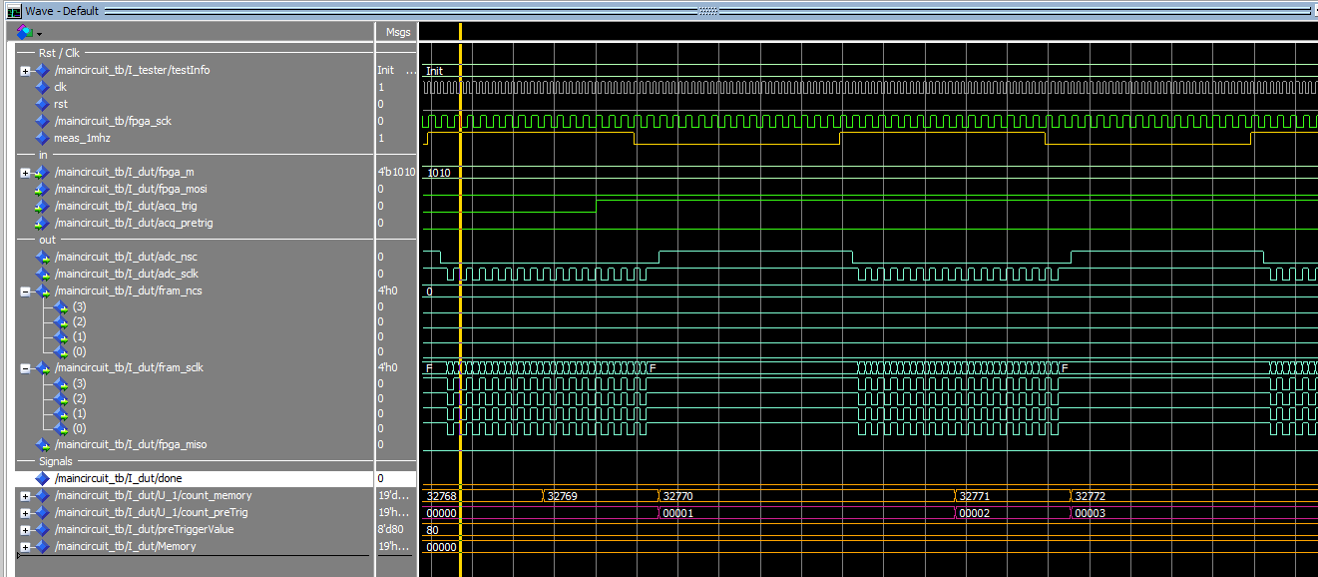
SIMULATION FPGA – TRIGGER
TRIGGER DETECTED

Slide 22
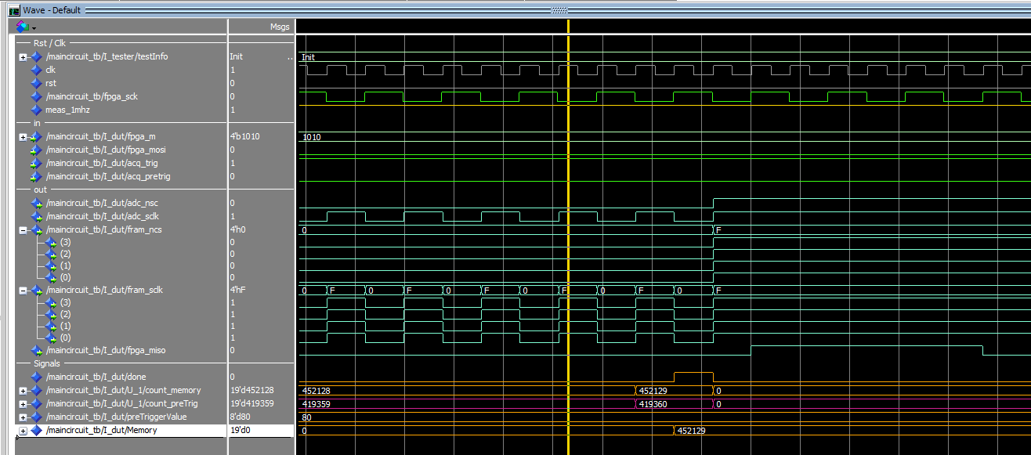
SIMULATION FPGA – DONE
STOP COUNTING – SEND VALUE TO STM32

Slide 23
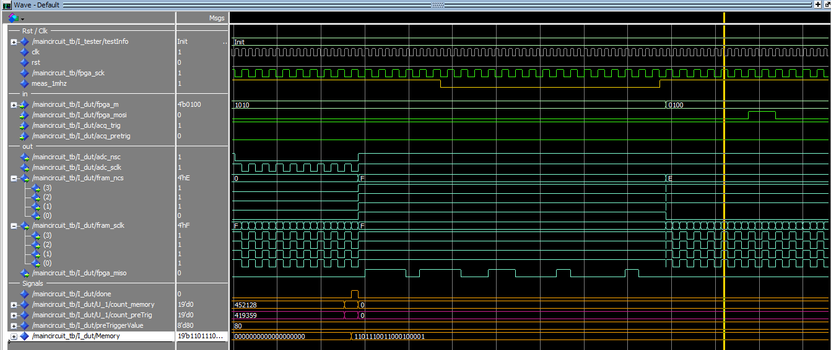
SIMULATION FPGA – DONE
STOP COUNTING – SEND VALUE TO STM32 // CHANGEMENT DE CLOCK

Slide 24
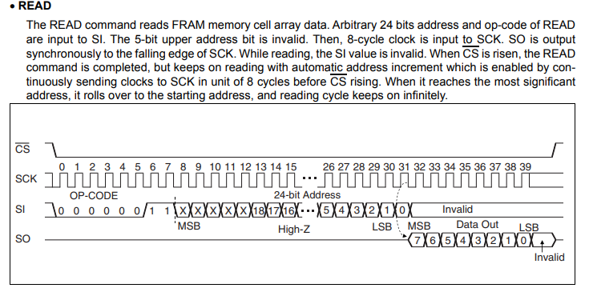
SIMULATION FPGA – FRAM READ

Slide 25
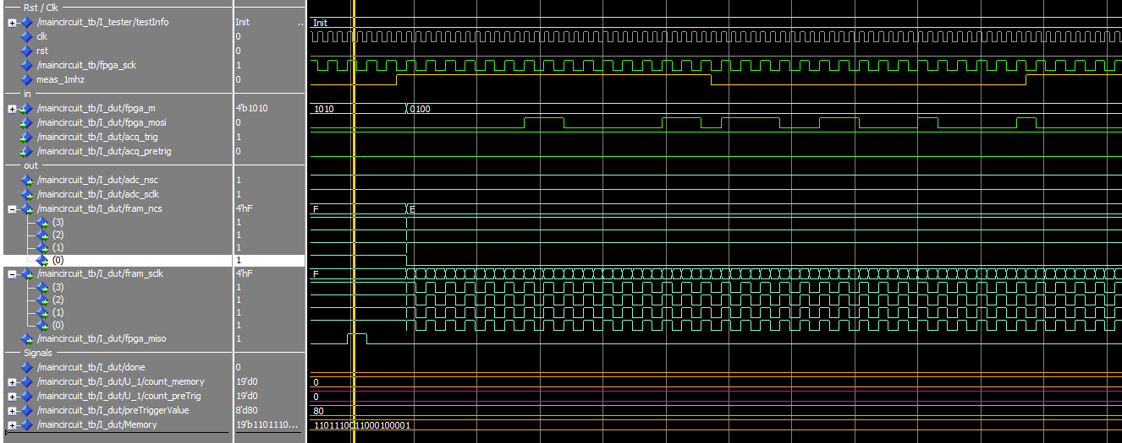
SIMULATION FPGA – FRAM READ

Slide 26
PROCHAINS OBJECTIFS :
CREER LA ROUTINE DE COMMUNICATION FPGA – STM32
TRANSFERER LES VALEURS DES FRAMS SUR LA CARTE SD
FAIRE LES TESTS REELS
UTILISATIONS DES CAPTEURS

